Slide 1
TechShoi
Database
Application
Updated
Check for this
Ahammad Shawki

Slide 2
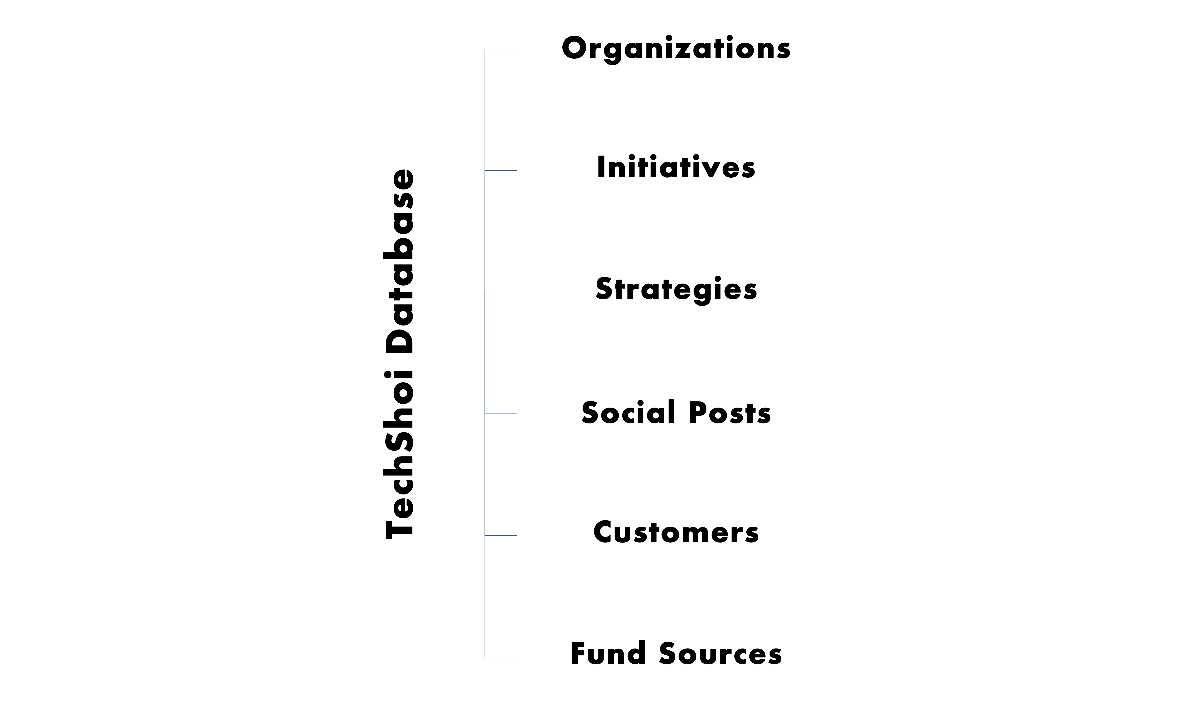
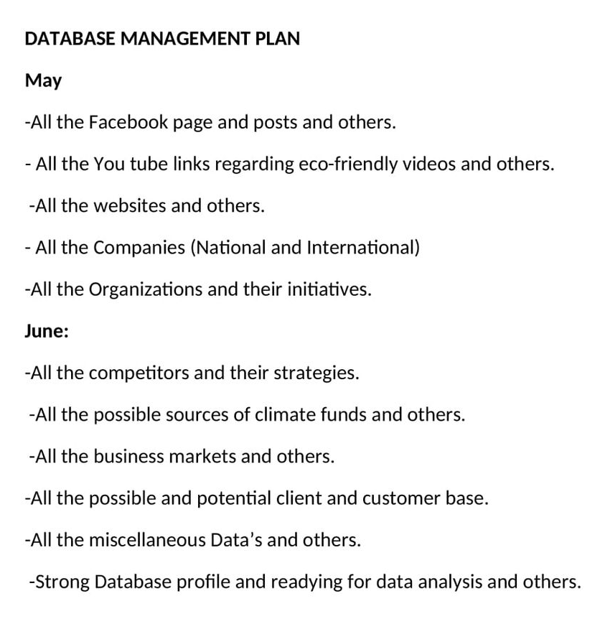
Fulfilling Requirements
Consumer
Tables - Requirements Plan

Slide 3
Tables
Columns
Relationships
Plan.

Slide 4
Databases & Tables
Database = 2
Authentication Database
Authentication Tables = 2
Core Database
Old Tables = 6
New Tables = 2

Slide 5
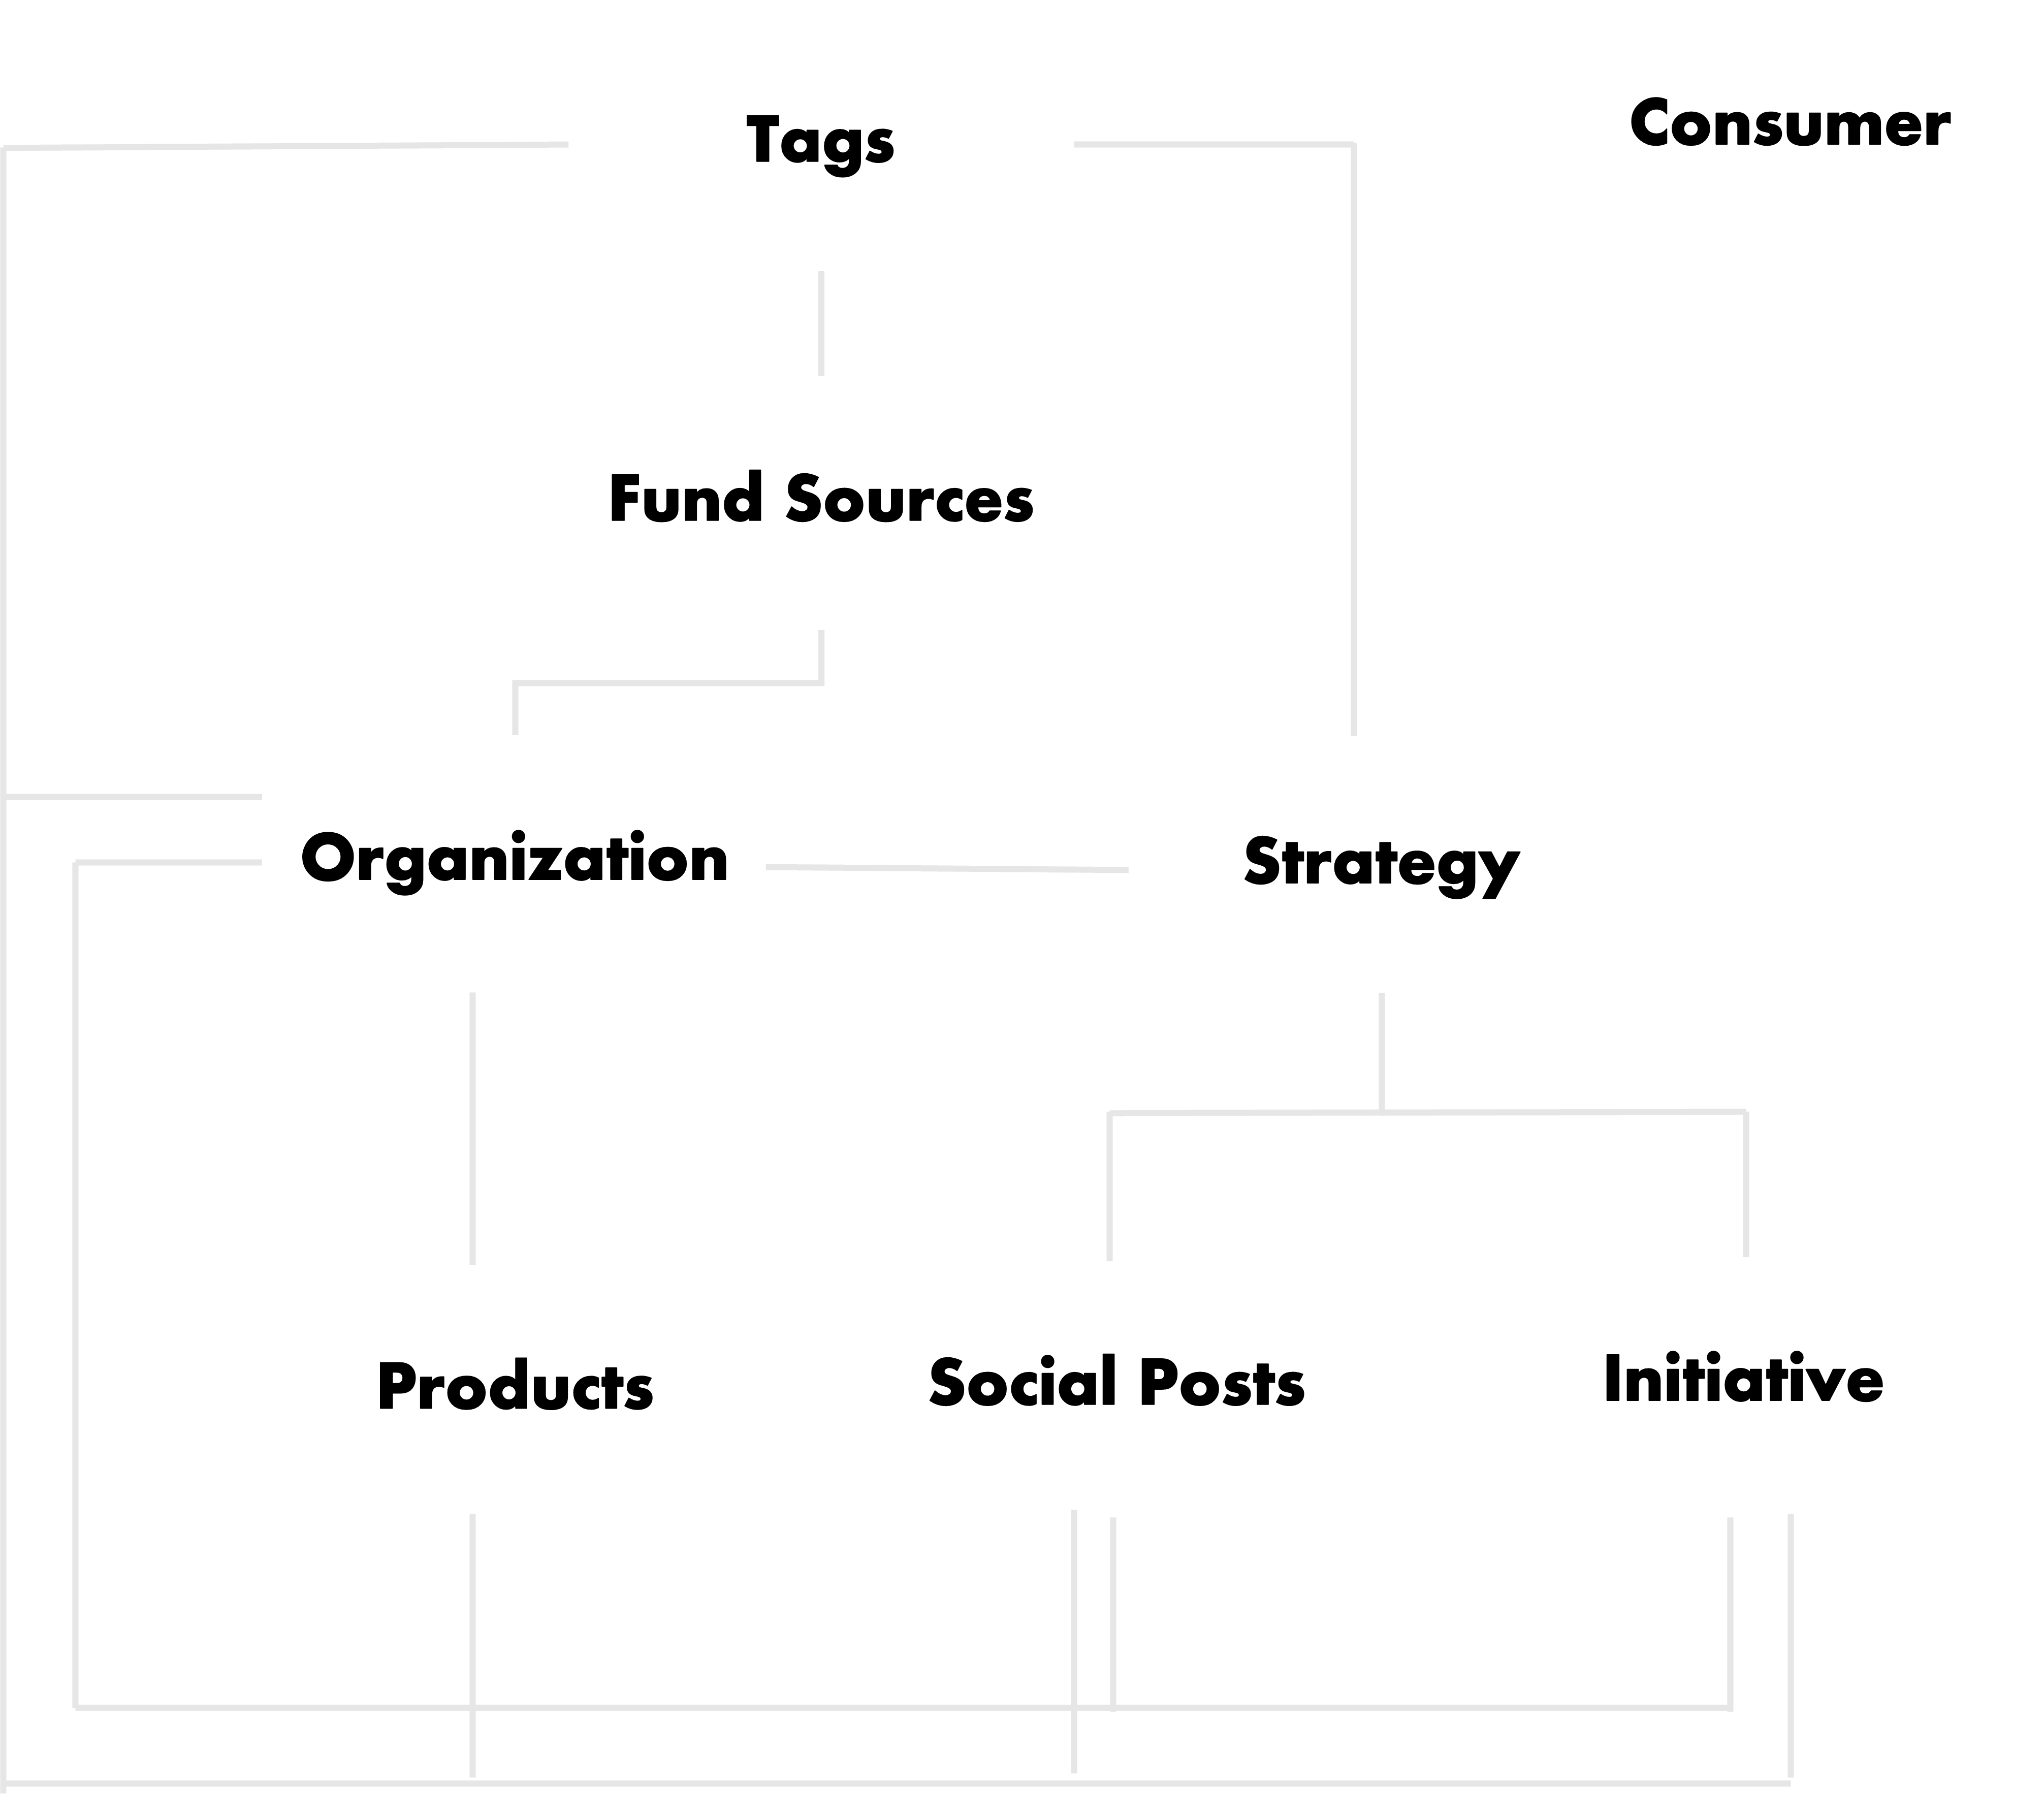
Tables Dependency Chart

Slide 6
New Table
Tags
Id | UUID, PRIMARY KEY, NOT NULL
Value | CHARFIELD(MAX_LENGTH = 50), NOT NULL

Slide 7
Fund Sources
Id | UUID, PRIMARY KEY, NOT NULL
Name | CHARFIELD(MAX_LENGTH=100), NOT NULL
Location | CHARFIELD(MAX_LENGTH=100), NOT NULL
Email | EMAIL_FIELD, UNIQUE CONSTRAINT, NOT NULL
Website | URL_FIELD, NOT NULL
Funding Possibility | SELECT_FIELD (Low | Medium | High), NOT NULL
Tags | MANY-TO-MANY RELATIONSHIP, NULL

Slide 8
Organizations
Id | UUID, PRIMARY KEY, NOT NULL
Name | CHARFIELD(MAX_LENGTH=100), NOT NULL
Location | CHARFIELD(MAX_LENGTH=100), NOT NULL
Category | SELECT_FIELD (COMPETITOR | NEUTRAL | MARKET | VENDORS), NOT NULL
Email | EMAIL_FIELD, UNIQUE CONSTRAINT, NULL
Site | URL_FIELD, NULL
Status | SELECT_FIELD(ACTIVE | INACTIVE), NOT NULL
Funders Id | MANY-TO-MANY RELATIONSHIP
Tags | MANY-TO-MANY RELATIONSHIP, NULL

Slide 9
Strategies
Id | UUID, PRIMARY KEY, NOT NULL
Name | TEXT_FIELD, NOT NULL
Organization | FOREIGN KEY, NULL
Tags | MANY-TO-MANY RELATIONSHIP, NULL

Slide 10
Initiatives
Id | UUID, PRIMARY KEY, NOT NULL
Name | TEXT_FIELD, NOT NULL
Date | DATEFIELD, NULL
Link | URL_FIELD, NULL
Organization Id | FOREIGN KEY, NOT NULL
Strategy Id | MANY TO MANY RELATIONSHIP
Tags | MANY-TO-MANY RELATIONSHIP, NULL

Slide 11
Social Posts
Id | UUID, PRIMARY KEY, NOT NULL
Platform | CHARFIELD(MAX_LENGTH=100), NOT NULL
Date | DATEFIELD, NULL
Link | URL_FIELD, NOT NULL
Organization Id | FOREIGN KEY, NOT NULL
Strategy Id | MANY-TO-MANY RELATIONSHIP, NOT NULL
Tags | MANY-TO-MANY RELATIONSHIP, NULL

Slide 12
New Table
Products
Id | UUID, PRIMARY KEY, NOT NULL
Name | CHARFIELD(MAX_LENGTH = 100), NOT NULL
Price | INTEGER FIELD, NOT NULL
Date | DATEFIELD, NULL
Features | TEXT_FIELD, NOT NULL
Link | URL_FIELD, NULL
Organization Id | FOREIGN KEY, NOT NULL
Tags | MANY-TO-MANY RELATIONSHIP, NULL

Slide 13
Consumer
Id | UUID, PRIMARY KEY, NOT NULL
Full name | CHARFIELD(MAX_LENGTH = 100), NOT NULL
Email | EMAIL_FIELD, UNIQUE CONSTRAINT, NULL
Age | INTEGER_FIELD, NOT NULL
Location | TEXT_FIELD, NULL
Social Link | URL_FIELD, NULL

Slide 14
DATA
ANALYSIS &
VISUALIZATION
Plan.

Slide 15
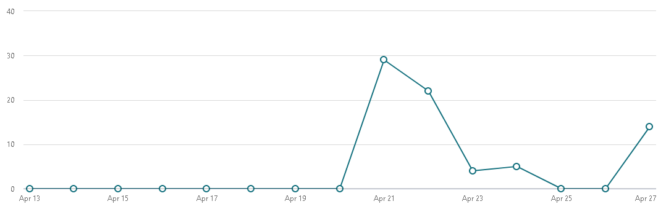
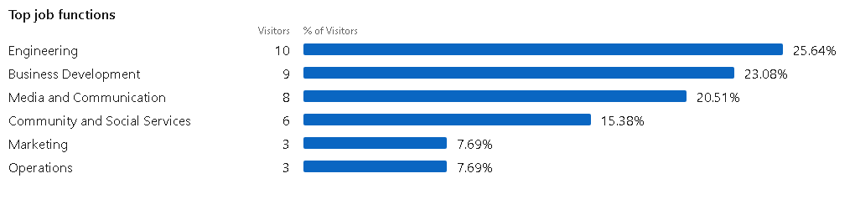
SOME EXAMPLES
LinkedIn

Slide 16
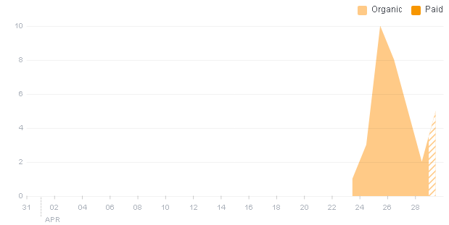
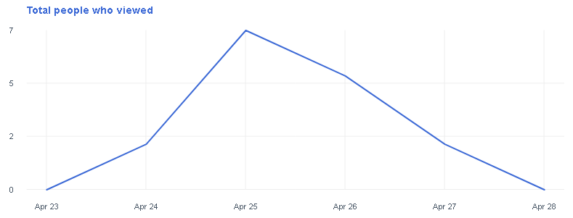
Facebook

Slide 17
Data Analysis Ideas
Location
User
Organization
Fund Sources
User Age
Product Price
Organization Category
Organization Status
Social Post Platforms
Fund Sources Funding Possibility

Slide 18
Quick Recap
Features
Access data easily ✔
User friendly interface ✔
Customizable with-comment code ✔
Universally unique identifiers ✔
Backup data in excel sheets ✔
Data analysis support
4 layered Security Measurements ✔
Responsive Web Application ✔
Data Entry Focused Application ✔

Slide 19
Implementations
UIUX

Slide 20



